Slide 1

Psychopaths

Slide 2



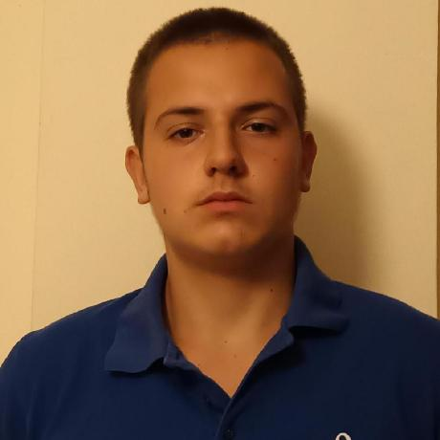

TEAM
Angel Angelov
Ivan Delchilov
Gabriel Dimitrov
Stiliyan Mishev

Slide 3

Idea

Slide 4

Stages
1. Discussing the idea
2. Coding
3. Debugging
4. Present the project

Slide 5







Used programs

Slide 6

Let's jump to the game

Slide 7

Thank you for your attention

